Slide 1

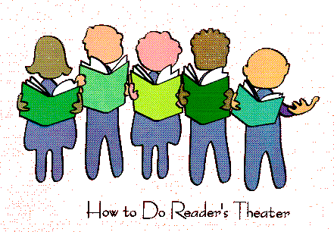
What is
Reader Theater?

Slide 2
• It is a performance, usually an adaptation of an existing literary work.
• Actors use their voices, facial expressions and gestures to convey the image of the scene.
• It’s not ‘acted’ with physical movement.
• Performers use scripts as a guide.

Slide 3
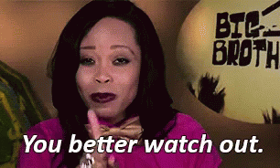
How do we create a script?
Select the story, text or scene you wish to perform
Decide who will play which character ~ remember to
include a narrator
3. All members of the group must
speak

Slide 4
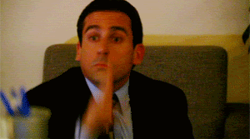
• Long speeches
• Difficult language
• Rude or inappropriate language that
may offend members of your audience
• Over use of ‘he said’ or ‘she said’ by
the narrator

Slide 5
Remember…
• Be confident.
• Speak clearly.
• Be enthusiastic.
• Have fun!

Slide 6
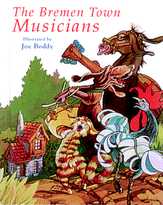
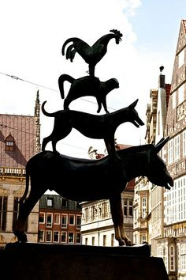
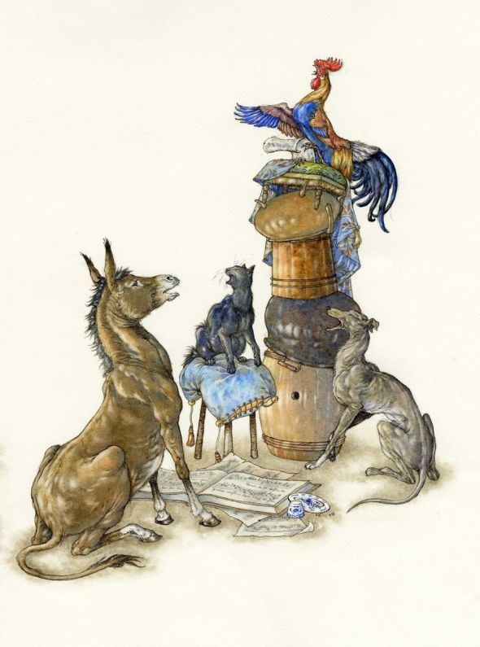
The Bremen Town Musicians

Slide 7
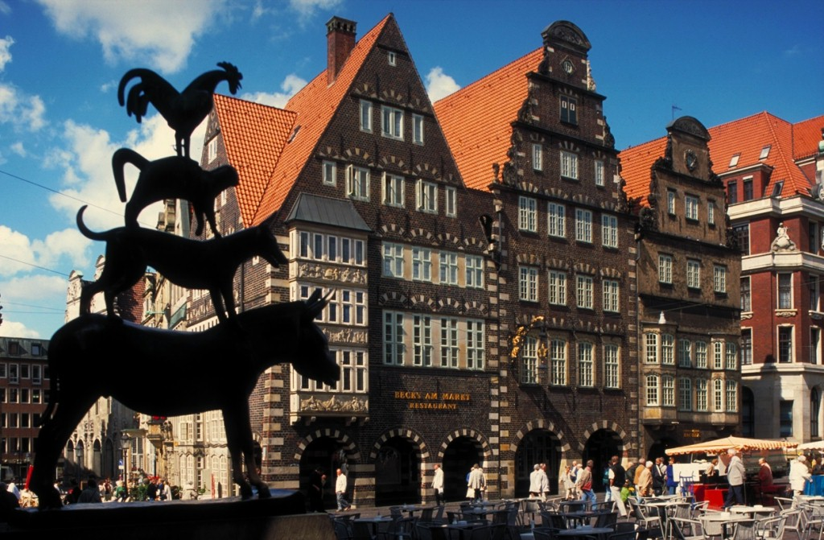
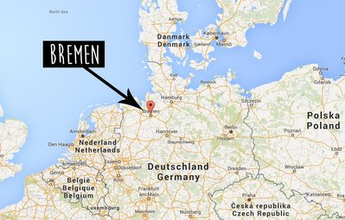
https://www.youtube.com/watch?v=-s_hj2_IHZI

Slide 8
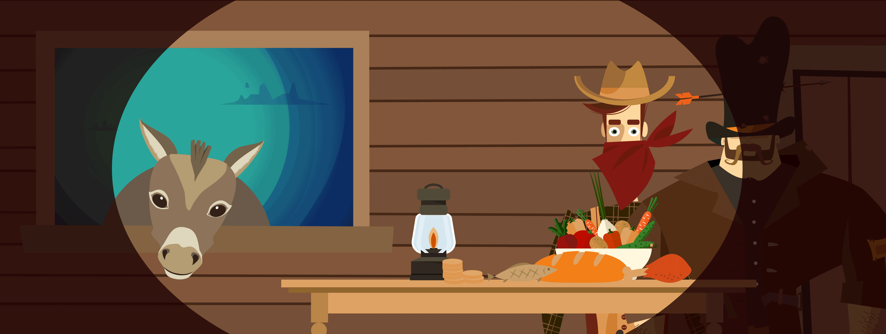
Bremen Town Musicians

Slide 9
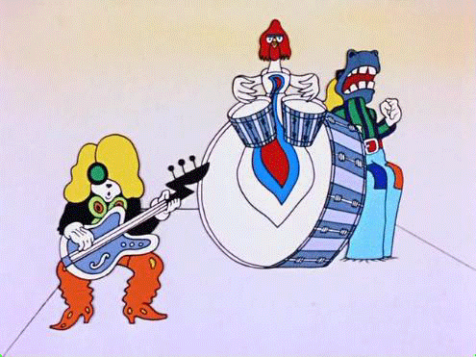


Slide 10
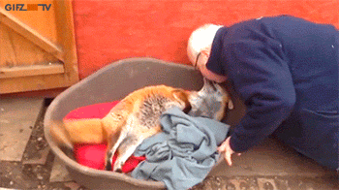
master主人
the person who owns, cares for, and controls an animal

Slide 11
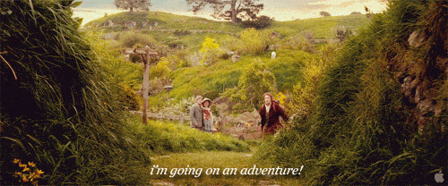
set out/set out啟程
to start a journey

Slide 12
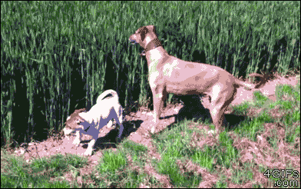
hunting dog獵犬

Slide 13
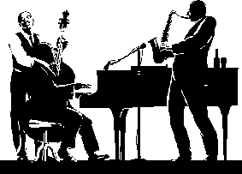
musicians
A person who sings, plays, or writes music.

Slide 14
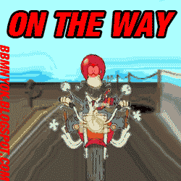
on the way to…
在往某地的路上

Slide 15
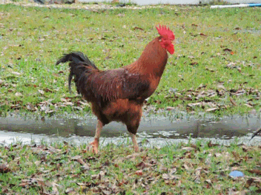
rooster公雞
an adult male chicken

Slide 16
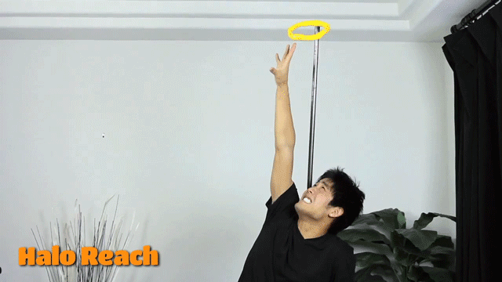
reach抵達
to arrive at a place

Slide 17
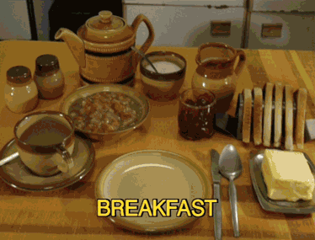
meal餐
an occasion when food is eaten

Slide 18
robbers
People who rob or steal.

Slide 19
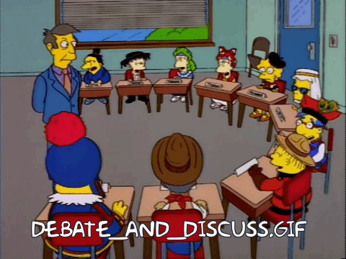
discuss討論
to talk about a subject with someone and tell each other your ideas or opinions

Slide 20
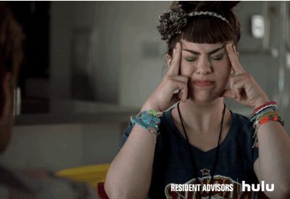
come up with想出
to suggest or think of an idea or plan

Slide 21
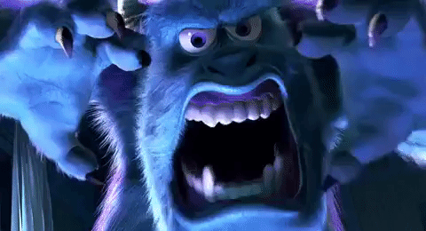
monster
any imaginary frightening creature, especially one that is large and strange

Slide 22

partnership
when two or more people become partners and join together to share something.

Slide 23
Rules in RT’s competition
1. 發音&語調&流暢性: 55%
2.創意表現:15% (僅限聲音部分)
3.團隊合作:20%
4.上下台及觀賞秩序:10 %
5.時間:每組限3~5分鐘

Slide 24
日期: 3/27(二)
地點:演藝廳
比賽時請穿著班服
劇本裝入學生學習檔案中攜帶上台
請勿準備任何佈景/道具或配樂，請無須編排具中角色之動作(非評分項目)。
市賽代表選手由評選小組擇優推選。
被選為代表選手須配合練習時間，若無法配合練習或態度不佳，指導老師可更換選手。

Slide 25
Roles
1. Narrators
2. Donkey
3. Dog
4. Cat
5. Rooster
6. robbers

Slide 26
Homework in winter vacation
1. 熟讀RT原劇本
2. 完成兩頁學習單
3. 想想自己適合什麼角色
4. 想想台詞可做哪些聲音上的變化
(例如:加入一小段配樂或歌曲、
某句台詞適合的情緒表現)
★比賽前的每堂英文課都要帶劇本

